Slide 1
Team Name Preliminary Design Review
University/Institution
Team Members
Date

Slide 2
Template Notes:
You can reformat this template to fit your design, but you must cover all the information requested on the following slides
This template contains all of the information you are required to convey at the PDR level. If you have questions, please contact me directly:
rocksatx@gmail.com

Slide 3
Template Notes:
The Goals of the PDR are:
Clearly present a Preliminary Design of your payload
Science objectives (theory, background, and what mission will prove) are understood and well-defined
Preliminary mission requirements are defined and traceable to science objectives
Understand concept of operations
Understanding of the overall design has increased from concept to preliminary design

Slide 4
PDR Presentation Content
Section 1: Mission Overview
Mission Statement
Mission Objectives
Theory and Concepts
Concept of Operations
Expected Results
Minimum Success Criteria

Slide 5
PDR Presentation Content
Section 2: System Overview
Science Design Overview
Engineering Design Overview
Top Level Requirements
Functional Block Diagram
Description of Partnerships – with sponsors/collaborators (i.e. NASA or company)
User Guide Compliance
Special Requests from Rocket/Wallops

Slide 6

PDR Presentation Contents
Section 3: Subsystem Design
Structures
Power
Science
Command and Data Handling
Software
Other
Include drawings/pictures of design with dimensions, schematics, pictures of hardware, etc.
jessicaswanson.com

Slide 7
PDR Presentation Contents
Section 4: Risk Matrices
Section 5: Initial Test Plan

Slide 8
PDR Presentation Contents
Section 6: Project Management Plan (PMP)
Schedule
Budget (Labor, launch fee, travel, hardware, etc)
Mentors (faculty, industry)
Latest Availability Matrix
Latest Team Contact Matrix
Status of deposit
Worries
Conclusions

Slide 9
1.0 Mission Overview
Name of Presenter

Slide 10
Mission Overview: Mission Statement
Present a concise Mission Statement
What do you expect to discover or prove?
Who will this benefit/what will your data be used for?
Make your case as to why this mission should fly on a rocket

Slide 11
Mission Overview: Mission Objectives
Mission Objectives → derived from mission statement
Break down into mission statement into your mission objectives
Should have 1 to 3 objectives

Slide 12
Mission Overview: Theory and Concepts
Give a brief overview of the underlying science concepts and theory
What other research has been performed in the past?
Results?

Slide 13
Mission Overview: Concept of Operations
Based on science objectives, present a diagram of what the payload will be doing during flight, highlights areas of interest
Looking for a general layout of when things will happen (don’t need exact times)
Example on following 2 slides

Slide 14
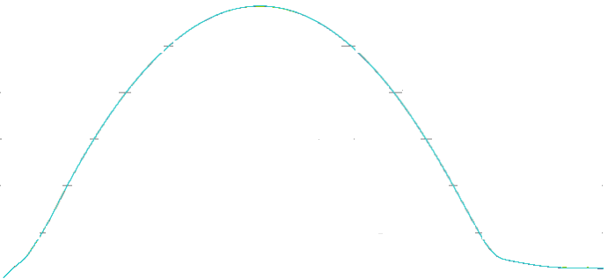
Example #1 ConOps
Altitude
t ≈ 1.7 min
Altitude: 95 km
Event B Occurs
t ≈ 4.0 min
Altitude: 95 km
Event C Occurs
t ≈ 1.3 min
Altitude: 75 km
Event A Occurs
Apogee
t ≈ 3 min
Altitude: ≈150 km
t ≈ 4.5 min
Altitude: 75 km
Event D Occurs
End of Orion Burn
t ≈ 0.6 min
Altitude: 52 km
t ≈ 5.5 min
Chute Deploys
t = 0 min
-G switch triggered
-All systems on
-Begin data collection
t ≈ 15 min
Splash Down

Slide 15
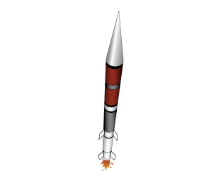
Example #2 ConOps
1. Launch
Telemetry/GPS begins
2. Launch to Apogee
Telemetry/GPS continues
3. Apogee
Nose cone separation
Skin separation
De-spin to TBD rate
Option to align with B Field
Telemetry/GPS continues
4. Descent
Telemetry/GPS continues
5. Chute Deploy
Telemetry/GPS continues
6. Landing
Telemetry/GPS terminates
Payloads recovered
3
4
5
2
1
6

Slide 16
Mission Overview: Expected Results
Go over what you expect to discover and what you data might look like
Ex. What wavelengths do you expect to see? How many particles do you expect to measure? How well do you expect the spin stabilizer to work (settling time?)? How many counts of radiation? Etc
This is vital in showing you understand the science concepts

Slide 17
Mission Overview: Success Criteria
Minimum Success Criteria:
What is the least amount of data you can collect that will still constitute a success?
Comprehensive Success Criteria:
What is the ideal amount of data to have full or comprehensive mission success?

Slide 18
2.0 System Overview
Name of Presenter

Slide 19
System Overview: Science Design Overview
Summarize the instrumentation/sensors/devices that will be used to complete your science mission
Present a concept of HOW your science hardware will work to achieve your mission

Slide 20
System Overview: Engineering Design Overview
Describe/summarize your current design (top level) used to support your Science Design
Be sure to cover major subsystems like Structures, Power, Command and Data Handling, Software
Utilization of heritage elements (designs/features used on previous flights) defined.
Major technology dependencies?

Slide 21
Top Level Requirements:
At the PDR level you should highlight the most critical (Top 3?) system and project level requirements and how they will be verified prior to flight (an example below).
Requirement | Verification Method | Description
They deploable boom shall deploy to a height of no more than 12” | Demonstration | Boom will be expanded to full length in the upright position to verify it doesn’t exceed 12”
The boom shall extend to the full 12” height in less than 5 seconds from a horizontal position. | Analysis | The system’s dynamical characteristics will be derived from SolidWorks, and available torques will yield minimum response time.
The full system shall fit on a single RockSat-X deck | Inspection | Visual inspection will verify this requirement
The sytem shall survive the vibration characteristics prescribed by the RockSat-X program. | Test | The system will be subjected to these vibration loads in June during testing week.

Slide 22
System Overview: Functional Block Diagram
Functional block diagram
Shows HOW subsystems interact with each other
Shows HOW data will be recorded and stored
Shows HOW power and data flow through subsystems
Example on following slide
I will spend a lot of time on this diagram with each team and it will be referred to all the way up until launch so make it good

Slide 23
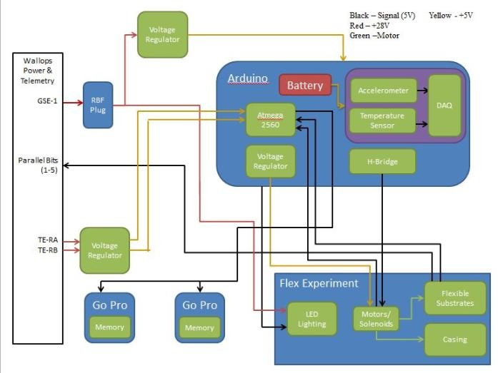
System Overview: Functional Block Diagram

Slide 24
System Overview: Description of Partnerships
Please describe any partnerships with sponsors and/or collaborators
Looking for details on the how partners will interact with students to bring the payload to launch readiness
What will be the role(s) of the partners?
What will they be providing to the mission and students involved?
Partnerships must have significant student involvement and cannot be simply flying hardware on a student launch opportunity.

Slide 25
System Overview: Special Requests
Please describe any special requests of the rocket and/or Wallops that are required for minimum and/or comprehensive mission success
Examples include but are not limited to:
Extra volume
Extra weight
High voltage
Extra telemetry
Faster sampling
Special environmental considerations

Slide 26
User Guide Compliance: Summary
Requirement | Status/Reason (if needed)
Center of gravity in 1" plane of plate?
Weight 30.0+/- 1.0 (15.0 +/- 0.5) lbs?
Max Height < 10.75” (5.13”)
Bottom of deck has flush mount hardware?
Within Keep-Out Zone
Using < 10 A/D Lines
Using/Understand Parallel Line
Using/Understand Asynchronous Line
Using X GSE Line(s)
Using X Non-Redundant PWR Lines (TE-1, TE-2, TE-3)
Using X Redundant Power Lines (TE-R)
Using < 1 Ah
Using <= 28 V
Using RF (If yes, list frequency and TX Power)
Using deployable?
Whole team consists of US Persons
Using ITAR and/or Export Controlled hardware

Slide 27
3.0 Subsystem Design
Name of Presenter

Slide 28
Subsystem Design
Detail each subsystem of your overall design
Each subsystem should be separated on to its own slide(s)
Expected subsystems follow

Slide 29
Subsystem Design: Structures
Include (where applicable):
Drawing(s) – Dimensioned and labeled
Power and data needs
Mechanical and Electrical Interfaces
Weight
Hardware required
Current issues
Other

Slide 30
Subsystem Design: Power
Include (where applicable):
Drawing(s) – Dimensioned and labeled
Power and data needs
Mechanical and Electrical Interfaces
Weight
Hardware required
Current issues
Other

Slide 31
Subsystem Design: Science
Include (where applicable):
Drawing(s) – Dimensioned and labeled
Power and data needs
Mechanical and Electrical Interfaces
Weight
Hardware required
Current issues
Other

Slide 32
Subsystem Design: Command and Data Handling
Include (where applicable):
Drawing(s) – Dimensioned and labeled
Power and data needs
Mechanical and Electrical Interfaces
Weight
Hardware required
Current issues
Other

Slide 33
Subsystem Design: Software
Include (where applicable):
Drawing(s) – Dimensioned and labeled
Power and data needs
Mechanical and Electrical Interfaces
Weight
Hardware required
Current issues
Other

Slide 34
Subsystem Design: Other
Include (where applicable):
Drawing(s) – Dimensioned and labeled
Power and data needs
Mechanical and Electrical Interfaces
Weight
Hardware required
Current issues
Other

Slide 35
4.0 Risk Matrices
Name of Presenter

Slide 36
Writing Risks – a note
When you write a risk, you are writing about the bad thing that might result, NOT the cause
Ex: “Risk 1: There might be one+ month delay in obtaining our science instrument” – not quite. This is the cause. The RISK is what this might do to your project, like delay testing, integration, schedule, etc, so you could write “Risk 1: The integration schedule will slip due to delays in procuring the science instrument”

Slide 37
Risk Matrix: (Subsystem Name)
Consequence |  | EPS.RSK.1 |  | EPS.RSK.3
 | EPS.RSK.4 | EPS.RSK.2
 | Possibility
Risks for the subsystem under discussion should be documented here
The horizontal represents the likelihood of a risk, the vertical is the corresponding consequence.
Risks placement should help drive mitigation priority
EPS.RSK.1: Mission objectives aren’t met IF microcontroller fails in-flight
EPS.RSK.2: Mission objectives aren’t met IF a suitable motor controller cannot be procured
EPS.RSK.3: The EPS system can’t survive launch conditions, and the mission objectives aren’t met
EPS.RSK.4: A strain will be put on the power budget IF flying monkeys delay the launch by an hour
Notes:
Don’t know about this one, it’s iffy

Slide 38
5.0 Test/Prototyping Plan
Name of Presenter

Slide 39
Test/Prototyping Plan
Describe how you will test/prototype each of the subsystems in your Functional Block Diagram
Goal is to eventually test your design as it will be flown
Develop a test plan that builds on the success of each test. For example, test power conversion subsystem before powering the instrument
Can be a table or detailed list by each test
Testing should have a logical flow
Include what risks these tests will help mitigate

Slide 40
6.0 Project Management Plan (PMP)
Name of Presenter

Slide 41
PMP: Management
Team Organization Chart
Preliminary schedule for the semester/year
Team mentors (industry, faculty)?
Monetary budget
Include launch fee, travel, labor, hardware, etc.
Also, include the status of your deposit

Slide 42
PMP: Latest Team Availability Matrix
You can copy and paste your availability spreadsheet here
Times should be in Mountain Time

Slide 43
PMP: Latest Contact Matrix
You can copy and paste your contact spreadsheet here

Slide 44
PMP: Worries
What are your biggest worries or potential failure points with your conceptual design?
Items identified should be completely mitigated through your design effort and fully addressed by CDR

Slide 45
PMP: Conclusions
Address why your mission deserves to fly
Next steps for your team to get to CDR
Anything you need to investigate further?
Begin requirement flow down process for system and subsystems

